Slide 1
IHE PCC - DCTM
“Care Team is for the care plan and the care plan is specific for the patient.”

Slide 2
Care Team DAM
Conceptual Model

Slide 3
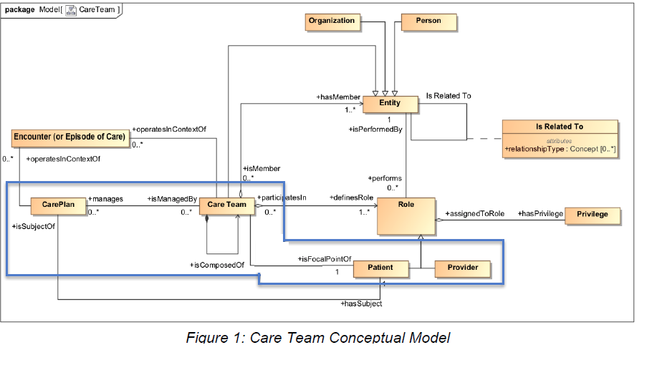

Slide 4
Care Team
The activities performed by care team members are generally specified in an explicit or implicit care plan managed by the care team.
The relationship between the care team and the care plan that guides its activities is fundamental to proper coordination of care

Slide 5
Care Team DAM
Logical Model - further elaborates the Care Team Conceptual Model by adding inheritance relationships, class attributes, and formal types to the concepts surfaced in the conceptual model.

Slide 6
Class: CarePlan
At this time, CarePlan is considered outside the CareTeam modelling. A CarePlan class is included in this document solely to demonstrate the relationship between a care team with the care plan(s) managed by the care team.

